Slide 1


CS106A: Programming Methodologies

Slide 2
Chris Piech
My parents are interesting folks
I originally concentrated in graphics and worked at Pixar
Childhood: Nairobi, Kenya
High School: Kuala Lumpur, Malaysia
Stanford University Ph.D. in Neural Networks
Research lab on AI for Social Good
The problem I really want to solve is to make high quality more education accessible

Slide 3
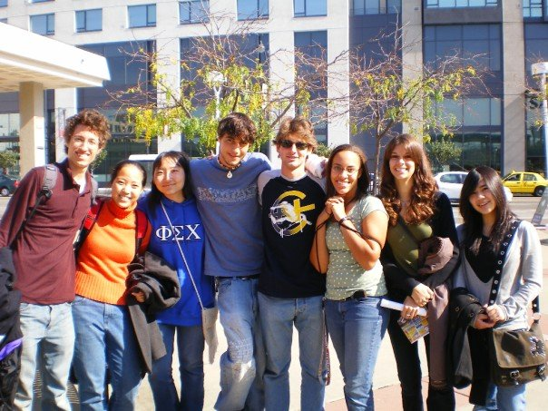
Chris Piech
11 years ago to this day, I was sitting in your seats

Slide 4
Head TA: Nick Troccoli

Slide 5
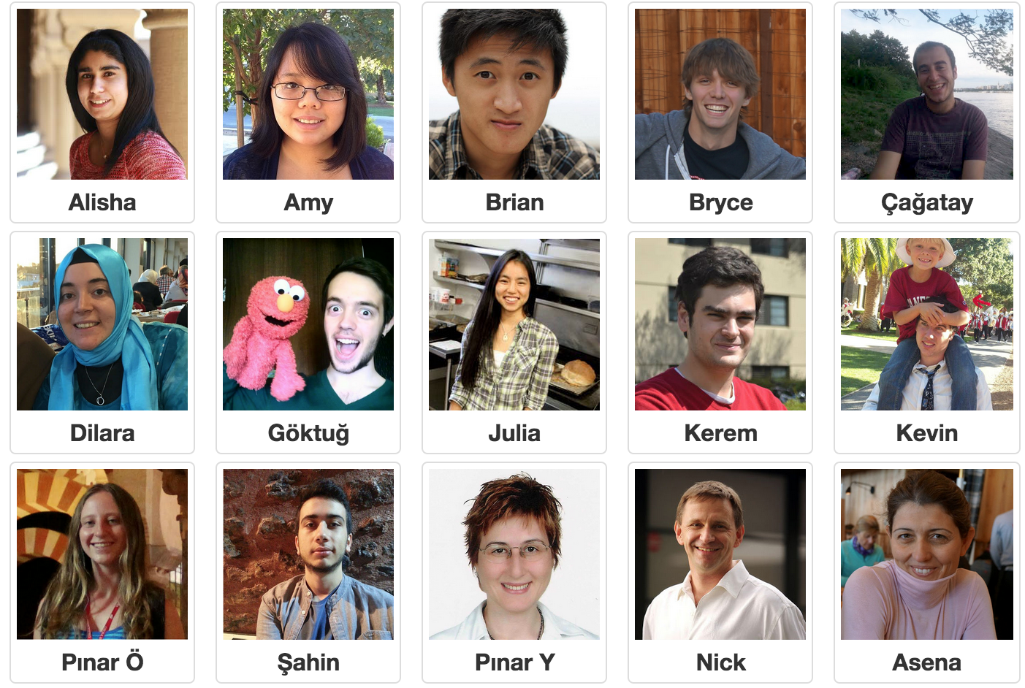
Section Leaders

Slide 6
Who are you?

Slide 7


Prerequisite Test
Notes:
Just need to know how to turn on a computer.
In fact about 7 years ago I was in your seats learning programming.
… and then I did the grad school thing and the teaching thing.
It worked out.

Slide 8
Course mechanics
(this is a light version. Please read the handout for details).

Slide 9
Course Website
http://cs106a.stanford.edu

Slide 10
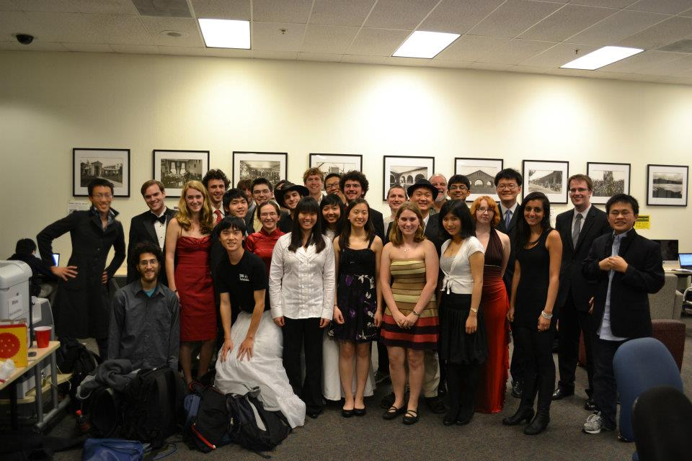
Lectures and Sections
Weekly 50-min section led by awesome section leaders (the backbone of the class!)
Signups begin on Thursday at 5:00pm and close Sunday at 5:00pm
Pair programming with others in your section.

Slide 11
Office Hours
LaIR: 6pm until midnight Sunday through Thursday (starting next Sunday)

Slide 12


Grading Scale
Functionality and style grades for the assignments use the following scale:
A submission so good it “makes you weep.”
Exceeds requirements.
Satisfies all requirements of the assignment.
Meets most requirements, but with some problems.
Has more serious problems.
Is even worse than that.
Better than nothing.

Slide 13
What we will ask you to do
*Two free late days

Slide 14
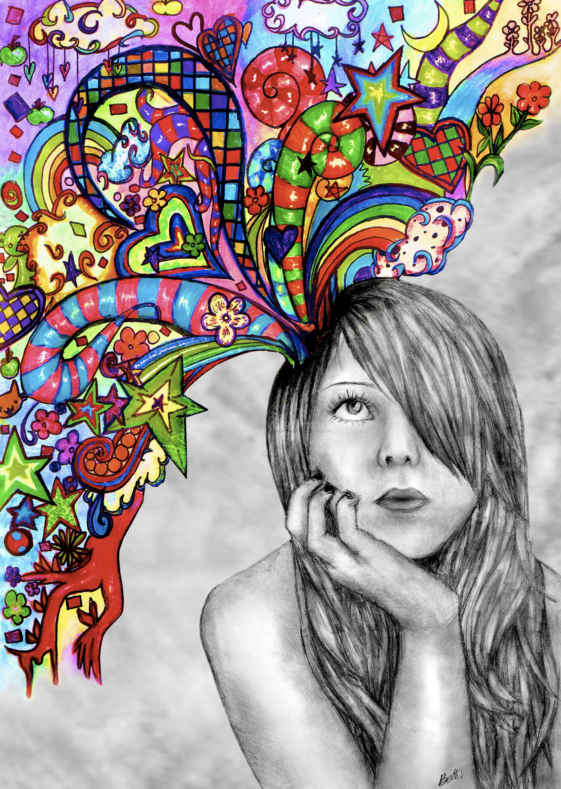
Optional Contest

Slide 15
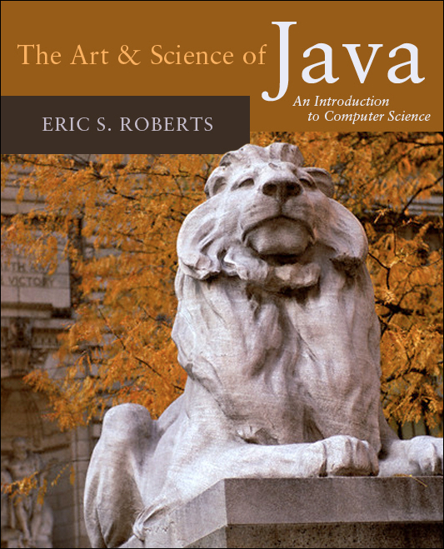
Textbook
The Art & Science of Java by Eric Roberts
written here at Stanford
tailored to this course
a valuable reference
usable on open-book exams
Karel the Robot Learns Java
First week of material

Slide 16
CS106A Units
Start Here
Average about 10 hours / week for assignments
Are you an
undergrad or
SCPD
student?
Do you want
to take CS106A for
fewer units?
No
Yes
3 Units
-or-
4 Units
Yes
No
5 Units

Slide 17
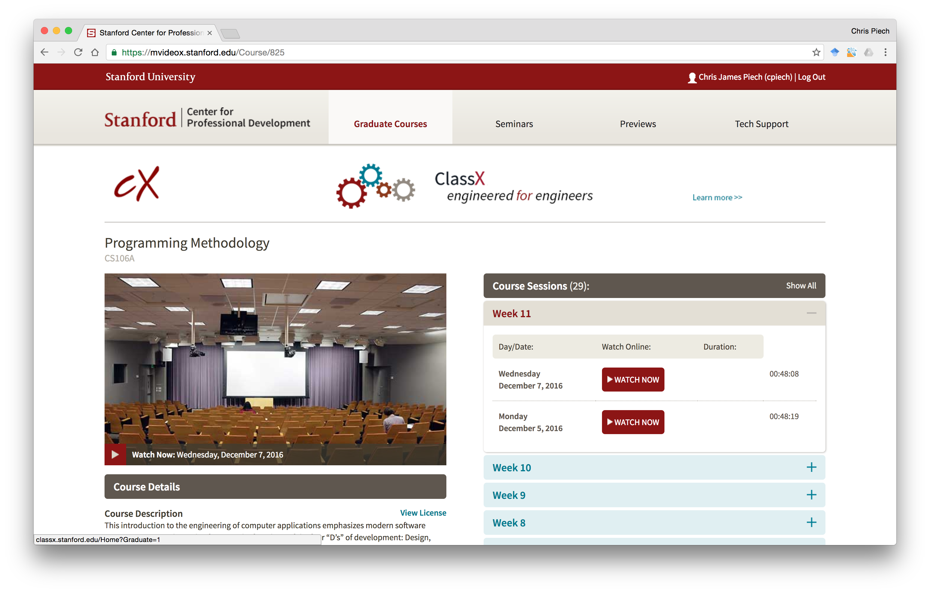
Lectures are Online

Slide 18
Are you in the right place?

Slide 19
What is CS106A?

Slide 20
Computer Science
Computer science is no more about computers than astronomy is about telescopes, biology is about microscopes or chemistry is about beakers and test tubes. Science is not about tools, it is about how we use them and what we find out when we do.
- Michael Fellows and Ian Parberry

Slide 21
Learning Goals
Learn how to harness computing power to solve problems.
To that end:
Explore fundamental techniques in computer programming.
Develop good software engineering style.
Gain familiarity with the Java programming language.

Slide 22
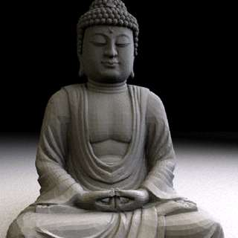
Art of Computer Science
Notes:
We teach software engineering principles. Much larger than just programming.
Mechanics of the language are nothing compared to the principles.
You are going to learn the principles by programming in Java

Slide 23
There are a lot of cool programs you may one day write

Slide 24
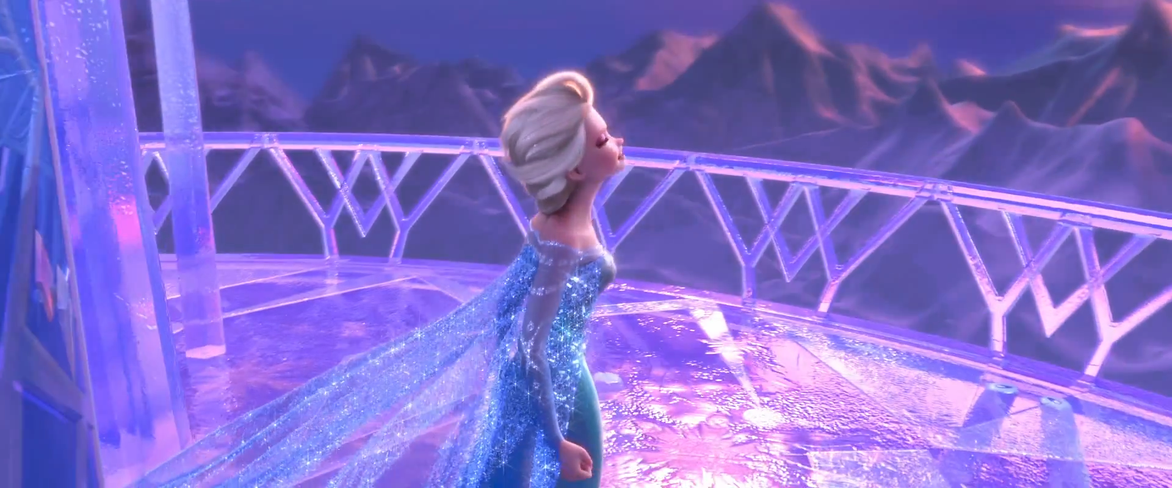
Computer Graphics
Pat Hanrahan, one of the founders of Pixar is a professor here

Slide 25
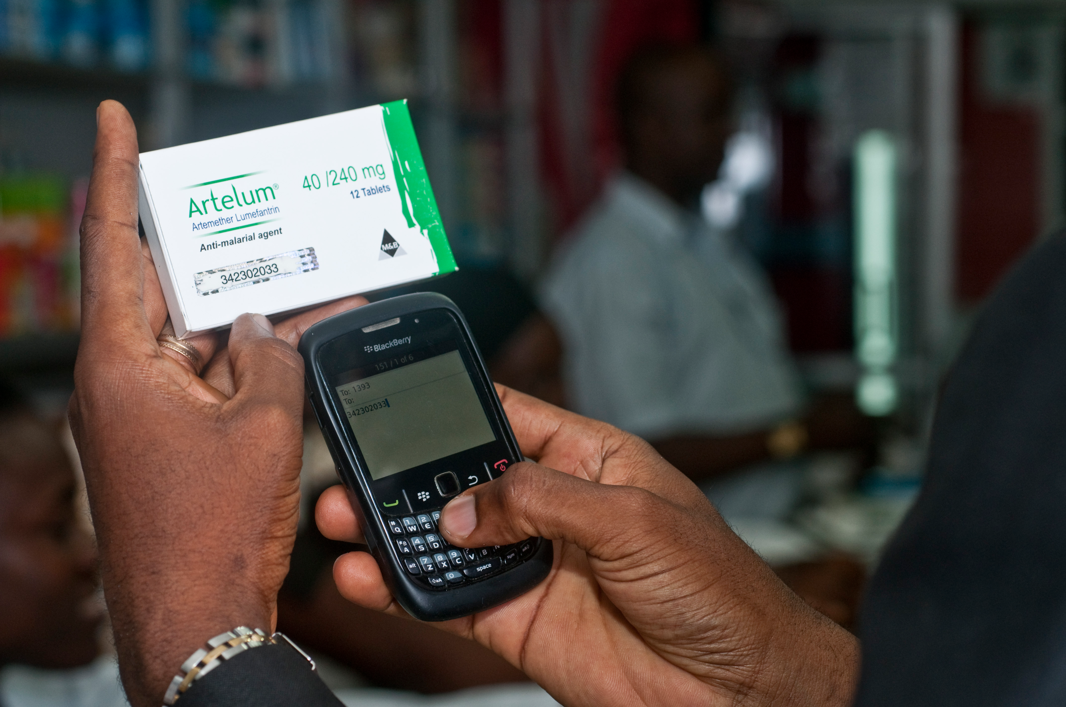

Consumer Applications
Notes:
Estimated 700,000 deaths from fame malaria and TB drugs in 2013:
http://www.un.org/africarenewal/magazine/may-2013/counterfeit-drugs-raise-africa%E2%80%99s-temperature
Bright Simmons from Ghana made an application which let people verify if their medication was authentic

Slide 26
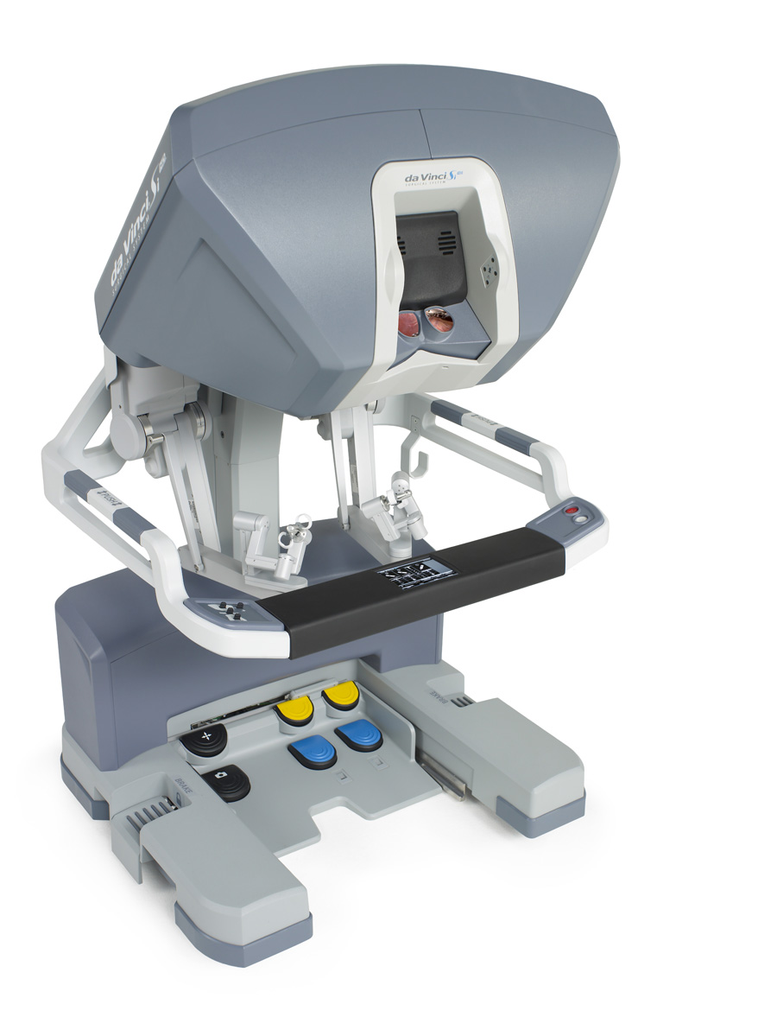
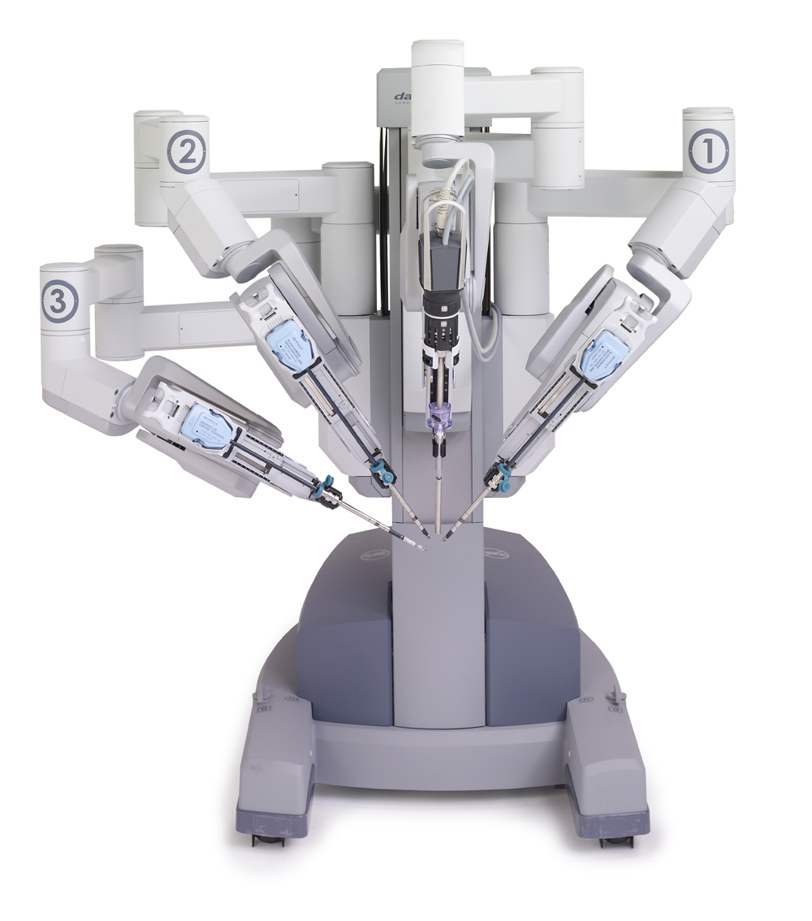
Autonomous Surgery
(c) 2012 Intuitive Surgical, Inc.

Slide 27
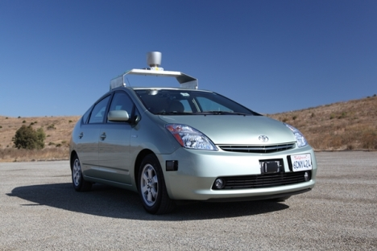
Self Driving Car

Slide 28
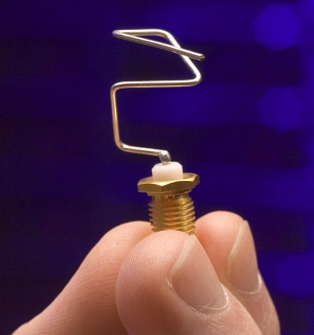
Genetic Algorithms
http://www.nasa.gov/centers/ames/images/content/144975main_ACD06-0043-007.jpg

Slide 29
If only we could program self driving cars…

Slide 30
Graphical Games

Slide 31
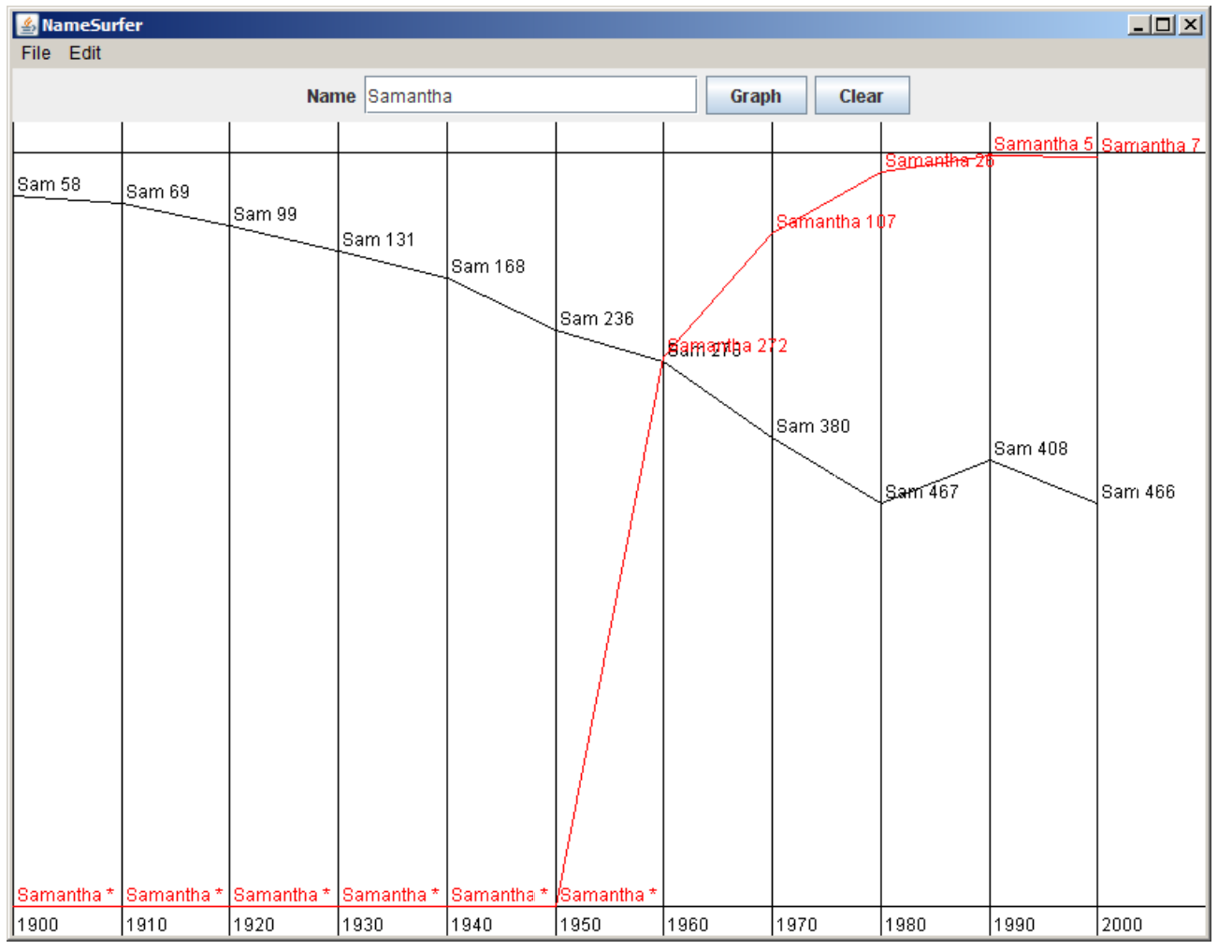
Data Visualization

Slide 32
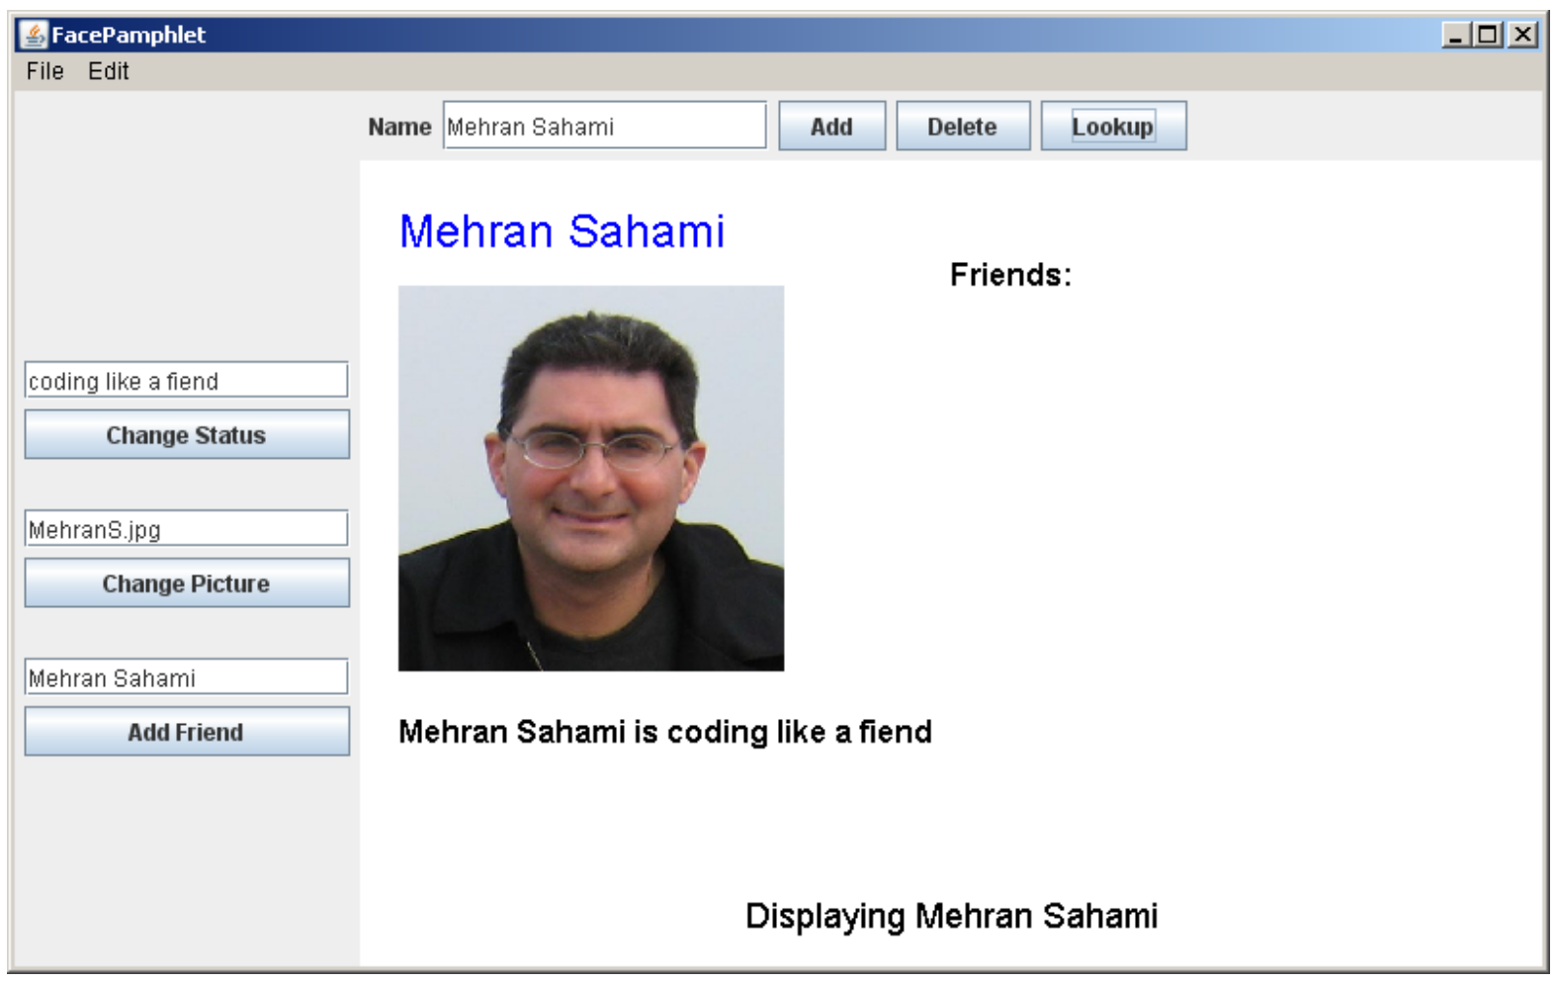
Mini Facebook

Slide 33
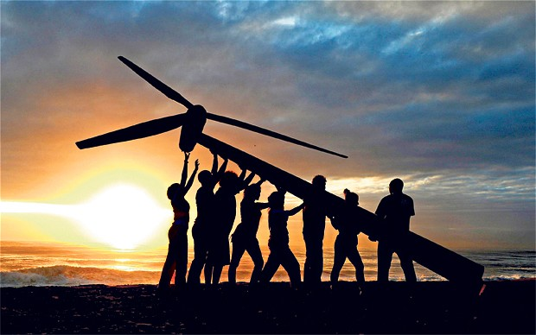
Strive for Everyone to Succeed
Notes:
We want all of you to be successful
That’s why we have such a large course staff
And its not like it’s a ya-ya course where we all hold hands and sing koombaya. Its real material.
But over years and years and years we have been working on our material so that everyone gets through…
Not competing against anyone but yourself

Slide 34
Feedback on How You Learn
Insert the video of code.org

Slide 35
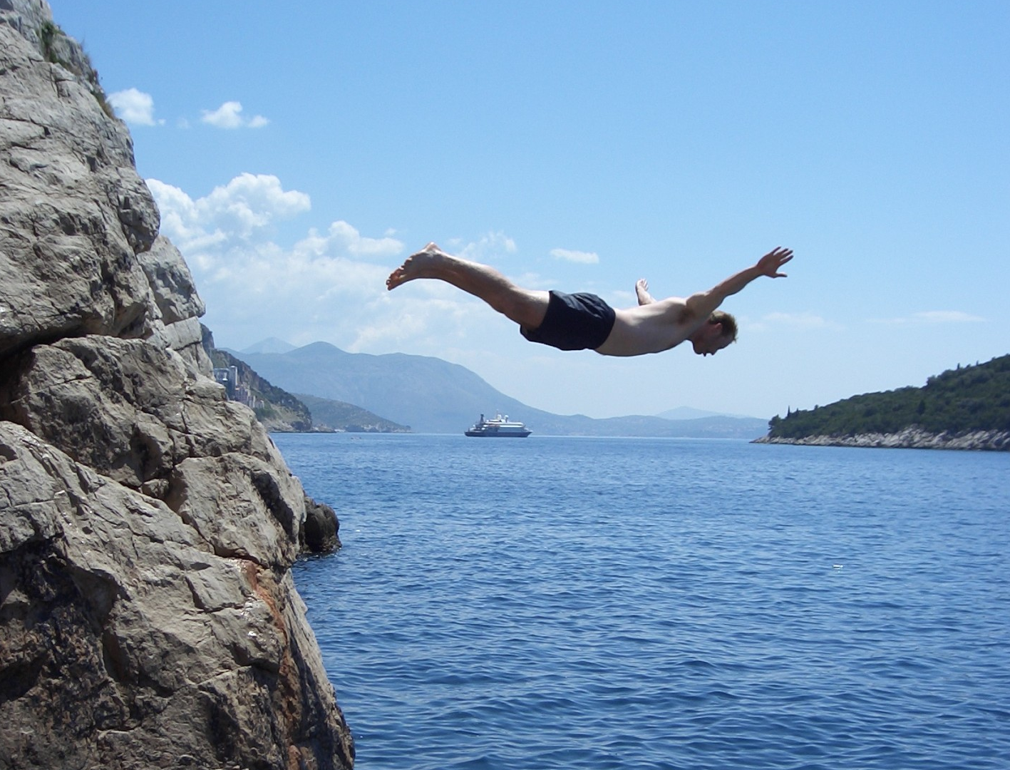
Lets Get Started

Slide 36
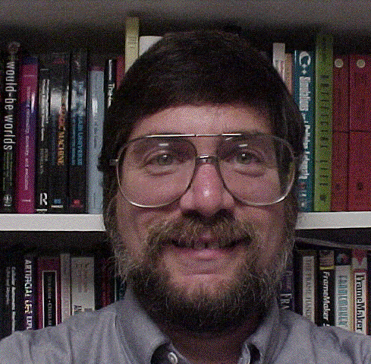

Meet Karel the Robot
Good morning
Notes:
He looks like an old machintosh machine.
Hes got legs… one sticks out the back. That’s just the way it is.

Slide 37

Karel Speaks Java
s
- #1 most commonly used programming language (mostly because of Android)
- Mostly it’s a great language for learning.
Notes:
Tomorrow you will learn that Karel is actually a very gentle introduction to programming

Slide 38

Karel’s World
North
3
+
+
+
+
+
2
+
+
+
+
+
West
East
1
+
+
+
+
+
South
1
2
3
4
5
Notes:
To you it might not be exciting but to karel its very exciting.

Slide 39

Walls
3
+
+
+
+
2
+
+
+
+
1
+
+
+
+
1
2
3
4

Slide 40

Beepers
3
+
+
+
+
2
+
+
+
+
1
+
+
+
+
1
2
3
4

Slide 41
Knows Four Commands
move();
turnLeft();
putBeeper();
pickBeeper();
Notes:
Tomorrow you will learn that Karel is actually a very gentle introduction to programming

Slide 42
move();

Slide 43

move();
3
+
+
+
+
2
+
+
+
+
1
+
+
+
+
1
2
3
4

Slide 44
move();
3
+
+
+
+
2
+
+
+
+
1
+
+
+
+
+
1
2
3
4

Slide 45
turnLeft();

Slide 46
turnLeft();
3
+
+
+
+
2
+
+
+
+
1
+
+
+
+
+
1
2
3
4

Slide 47
turnLeft();
3
+
+
+
+
2
+
+
+
+
1
+
+
+
+
+
1
2
3
4

Slide 48
pickBeeper();

Slide 49
pickBeeper();
3
+
+
+
+
2
+
+
+
+
1
+
+
+
+
+
1
2
3
4

Slide 50
pickBeeper();
3
+
+
+
+
2
+
+
+
+
1
+
+
+
+
+
1
2
3
4

Slide 51
Make Sense?

Slide 52
First Challenge
3
+
+
+
+
2
+
+
+
+
1
+
+
+
+
1
2
3
4

Slide 53
First Challenge
3
+
+
+
+
2
+
+
+
+
1
+
+
+
+
1
2
3
4

Slide 54
Bird’s Eye View
3
+
+
+
+
2
+
+
+
+
1
+
+
+
+
1
2
3
4
Karel is facing East

Slide 55
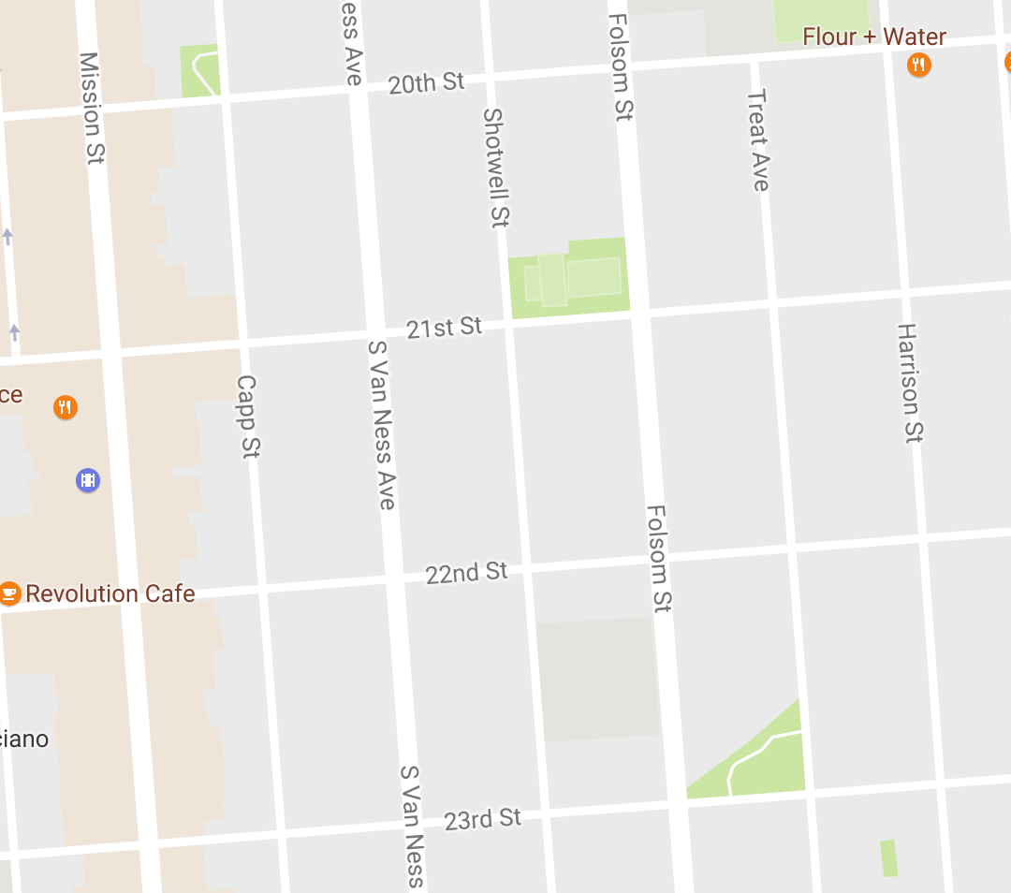
Bird’s Eye View
Karel is facing East

Slide 56
Turn Left
Karel is facing North

Slide 57
Turn Left
Karel is facing West

Slide 58
Turn Left
Karel is facing South

Slide 59
Move

Slide 60

Learn By Doing

Slide 61


Slide 62
Method Definition
private void name() {
method statements
}
This adds a new command to Karels vocabulary

Slide 63
Anatomy of a Program
import stuff
program definition{
public void run() {
commands
}
other methods
}

Slide 64
Anatomy of a Program
import stanford.karel.*;
public class OurKarelProgram extends Karel {
public void run() {
move();
pickBeeper();
move();
turnLeft();
move();
turnRight();
move();
putBeeper();
move();
}
private void turnRight() {
turnLeft();
turnLeft();
turnLeft();
}
}
This piece of the program's source code is called a method.

Slide 65
Anatomy of a Program
import stanford.karel.*;
public class OurKarelProgram extends Karel {
public void run() {
move();
pickBeeper();
move();
turnLeft();
move();
turnRight();
move();
putBeeper();
move();
}
private void turnRight() {
turnLeft();
turnLeft();
turnLeft();
}
}
x
This line of code gives the name of the method
(here, run)

Slide 66
Anatomy of a Program
import stanford.karel.*;
public class OurKarelProgram extends Karel {
public void run() {
move();
pickBeeper();
move();
turnLeft();
move();
turnRight();
move();
putBeeper();
move();
}
private void turnRight() {
turnLeft();
turnLeft();
turnLeft();
}
}
This line of code gives the name of the method
(here, turnRight)

Slide 67
Anatomy of a Program
import stanford.karel.*;
public class OurKarelProgram extends Karel {
public void run() {
move();
pickBeeper();
move();
turnLeft();
move();
turnRight();
move();
putBeeper();
move();
}
private void turnRight() {
turnLeft();
turnLeft();
turnLeft();
}
}
This is called an import statement. It tells Java what Karel is.

Slide 68
Anatomy of a Program
import stanford.karel.*;
public class OurKarelProgram extends Karel {
public void run() {
move();
pickBeeper();
move();
turnLeft();
move();
turnRight();
move();
putBeeper();
move();
}
private void turnRight() {
turnLeft();
turnLeft();
turnLeft();
}
}
This is called a code block

Slide 69
Anatomy of a Program
import stanford.karel.*;
public class OurKarelProgram extends Karel {
public void run() {
move();
pickBeeper();
move();
turnLeft();
move();
turnRight();
move();
putBeeper();
move();
}
private void turnRight() {
turnLeft();
turnLeft();
turnLeft();
}
}

Slide 70
Anatomy of a Program
import stanford.karel.*;
public class OurKarelProgram extends Karel {
public void run() {
move();
pickBeeper();
move();
turnLeft();
move();
turnRight();
move();
putBeeper();
move();
}
private void turnRight() {
turnLeft();
turnLeft();
turnLeft();
}
}

Slide 71
Anatomy of a Program
import stanford.karel.*;
public class OurKarelProgram extends Karel {
public void run() {
move();
pickBeeper();
move();
turnLeft();
move();
turnRight();
move();
putBeeper();
move();
}
private void turnRight() {
turnLeft();
turnLeft();
turnLeft();
}
}

Slide 72
Anatomy of a Program
import stanford.karel.*;
public class OurKarelProgram extends Karel {
public void run() {
move();
pickBeeper();
move();
turnLeft();
move();
turnRight();
move();
putBeeper();
move();
}
private void turnRight() {
turnLeft();
turnLeft();
turnLeft();
}
}

Slide 73
Anatomy of a Program
import stanford.karel.*;
public class OurKarelProgram extends Karel {
public void run() {
move();
pickBeeper();
move();
turnLeft();
move();
turnRight();
move();
putBeeper();
move();
}
private void turnRight() {
turnLeft();
turnLeft();
turnLeft();
}
}
The run method is “public” so that Eclipse can call it.

Slide 74
Anatomy of a Program
import stanford.karel.*;
public class OurKarelProgram extends Karel {
public void run() {
move();
pickBeeper();
move();
turnLeft();
move();
turnRight();
move();
putBeeper();
move();
}
private void turnRight() {
turnLeft();
turnLeft();
turnLeft();
}
}
The turnRight method is “private” to indicate it is only visible to our current program.

Slide 75
Why Study CS?

Slide 76
Joy of Building

Slide 77
Interdisciplinary

Slide 78

Closest Thing To Magic

Slide 79
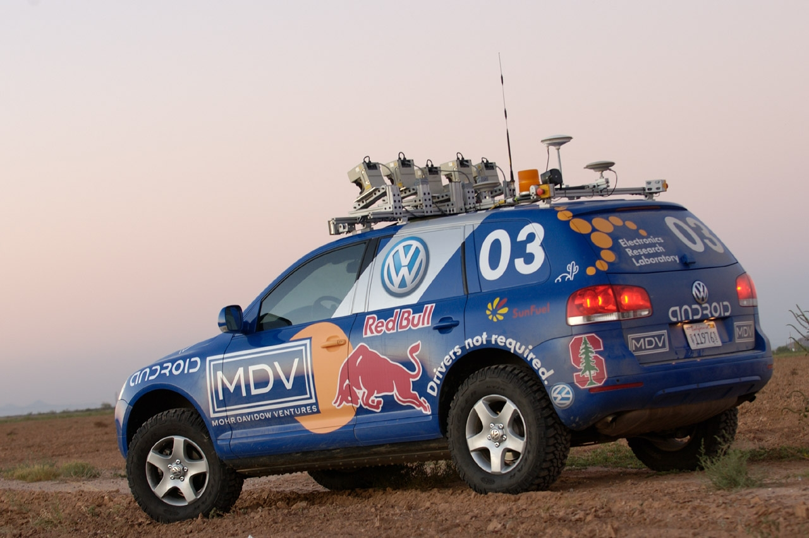

Now is the Time

Slide 80
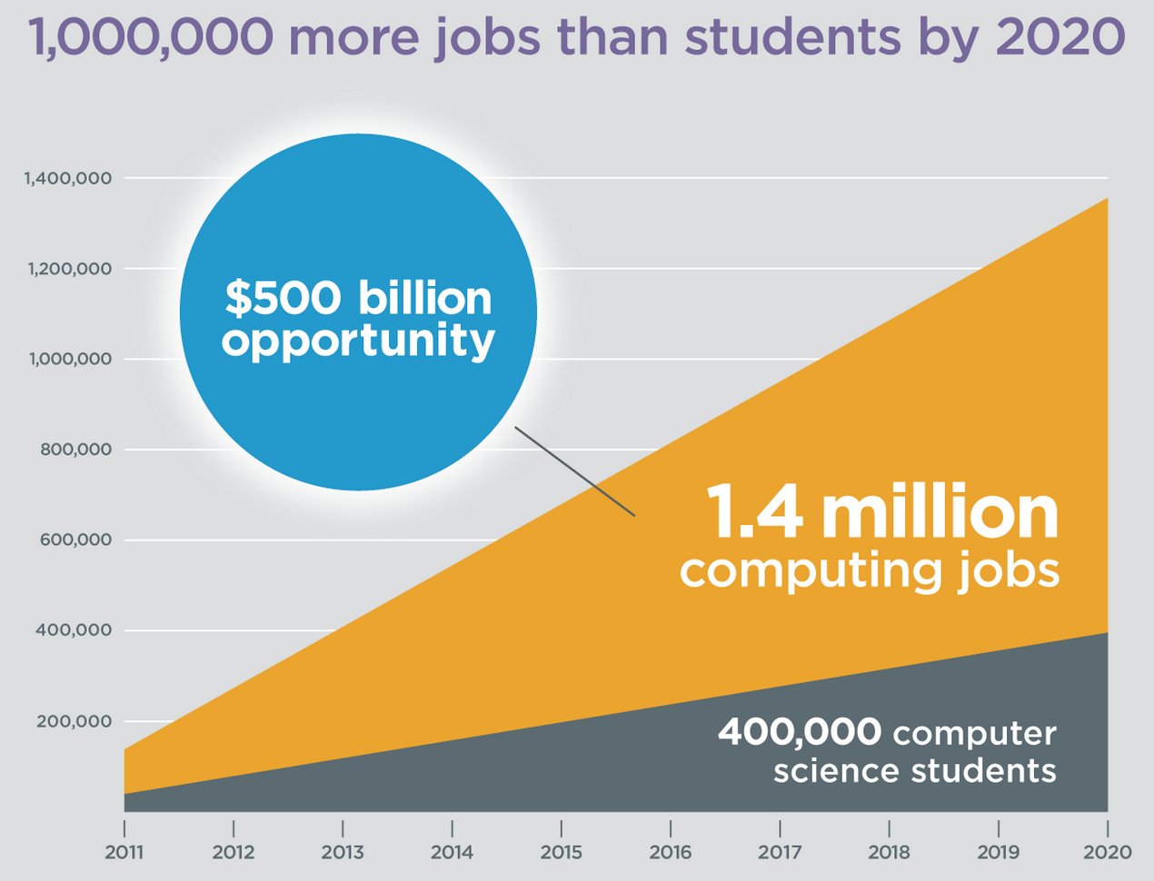
Oh and Its Useful
Code.org

Slide 81
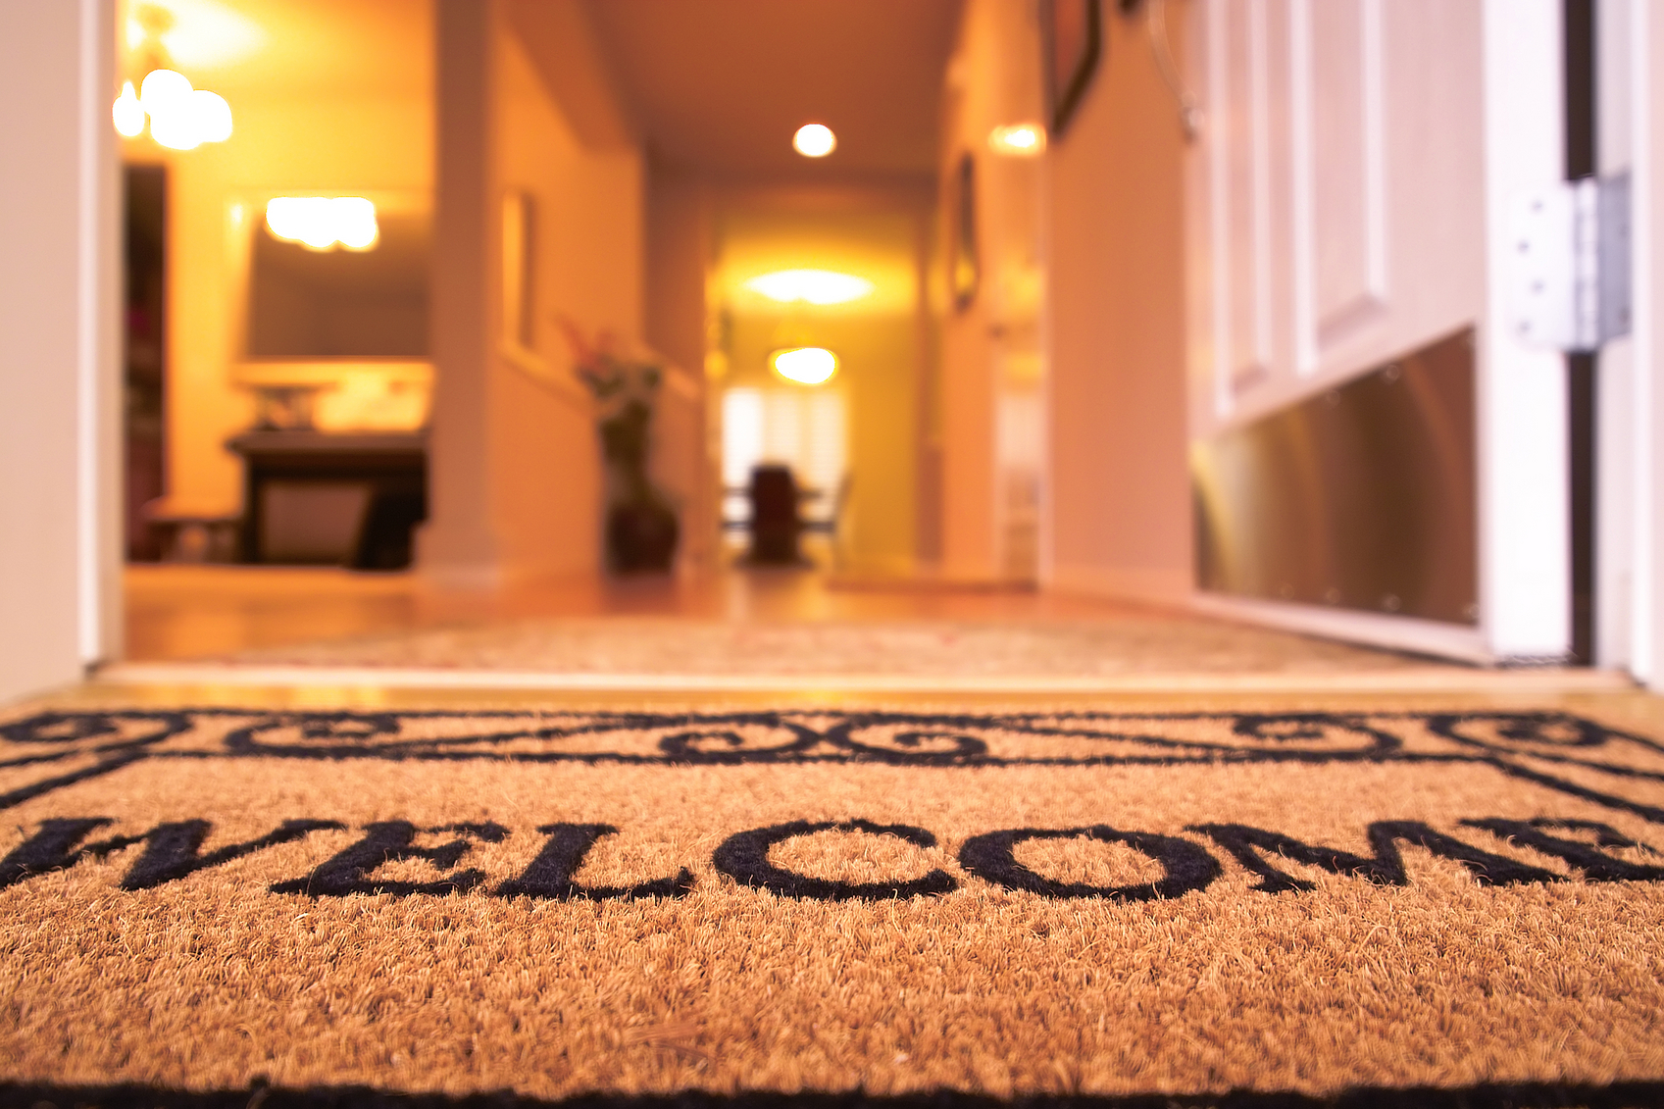
Everyone is Welcome

Slide 82
The End

Slide 83
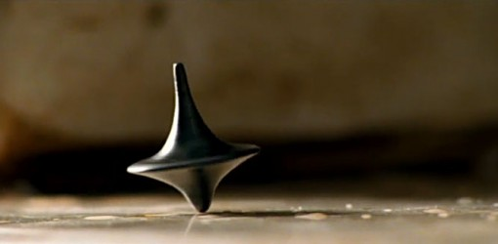
The End?

